Slide 1
How-to-app: technical overview
Developed by Benoit Favre, with contributions from Kevin Guanwan

Slide 2
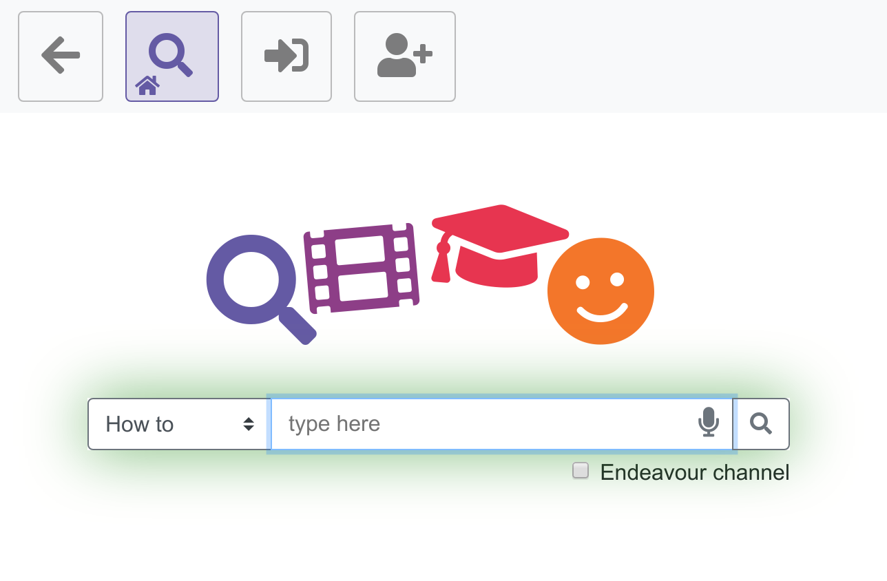
How-to-app: presentation
Specialized video search
  Support sustainable learning
Accessibility
  Search prompts
  Speech input
  Visual prompts
  Simplicity
  Responsive
Features
  Login and profile management
  Comment and share videos with friends
  Notifications
  Search on specific channel

Slide 3
How-to-app: technical details
Hosted at https://videosearch.designparticipation.net:8787
Python 3.7
  Aiohttp
  jinja2 templates
Mongodb database
  A lot of activity is logged for research purposes
Docker image
Requires HTTPS for embedding youtube videos
  Relies heavily on youtube data api

Slide 4
Infrastructure
Search
Youtube
Embedded player
Server (python)
Client (browser)
UI
MS speech
MongoDB
Google speech
Speech input
Remote services
Hosted server

Slide 5
Open issues
Security
  Login
  Spam
Scaling
  Use of youtube data api
  Use of microsoft speech recognition
  Database
Missing features
  Password recovery (workaround with QR codes)
  Delete / undo / edit a range of elements (playlists, comments...)

Slide 6
Potential extensions
Usability
  Login with physical object (NFC, RFID)
  Pre-populate users for a center, friend lists
Accessibility
  Commenting with video clips
  Visual browsing instead of search
  Get support
Teaching features
  Special teacher role
  Playlist sharing and commenting
  Objectives and skillset management
  Gamification of learning activity
Technical
  Caching of youtube calls
  Reorganisation of DB queries
  Scalability

